Slide 2
Email Server Configuration and Customization
Minor - I
Mid-Term Presentation
on
Project Mentor
Dr. Monit Kapoor
Associate Professor,
HOD(Department of Cybernetics)

Slide 3
Motivation
Emails have become a greater part of our lives. The Email, one organized well, is the most effective means of communication for business. A lot of companies nowadays have their privacy factors, in which they prefer to keep their delicate data inside their organizations. Thus, data can be shared with trust and under supervision by the organization. More versatile than anything it can be used to communicate with people in different parts of the world, but for a different organization, different types of configurations are required.
The customization done in the project are on the requirements that are generally required by the company to establish a smooth and reliable medium of communication with restriction of messages like maintaining the buffer log, automating the mail server to generate automatic backups, providing special restriction to unaccepted contents and to make the data searchable and easily accessible.

Slide 4
Objectives achieved so far
Implemented filtering of mail based on sensitive content, and if a mail contains sensitive content then the mail is marked as flagged and logs of such mail are maintained for administration purposes.
Designed a completely scripted package that provides the user with a UI (Java AWT) to send mail via postfix and in the backend, it inspects the mail for any sensitive content and thus performs filtration process.

Slide 5
Filtering of mails
In every organization, some privacy factors are needed to be followed by the employees. (Here privacy factors refers to any sensitive information related to the organization or some other purposes which must always remain in the organization itself).Even the employees must never use such a language which may lead to having issues in inter-organization or intra-organization.
Email is the primary source of communication in intra-organization or inter-organization. Thus every organization must have their email servers customized in such a way that the emails sent by their employees must be always filtered so that they get to know if any employee is breaking the boundaries.
Filtering of email is done on its content and is based on the resources (i.e. files which tells what is the sensitive content that should not be used in email).
The resource files are needed to be maintained and updated by the organization on regular intervals.

Slide 6
SCIMAIL
Scimail is the name which we have given to our scripted package , which when executed performs various code such as java AWT code for UI interface and C code providing functionality for filtering of mail based on sensitive content, and thus makes it all possible by running just one command in the shell.
The codes executed after running this shell command also sends mail using postfix and in the backend filtering is performed on the sent mail and so the backup of flagged mails (i.e. mails with sensitive content) is maintained.

Slide 7
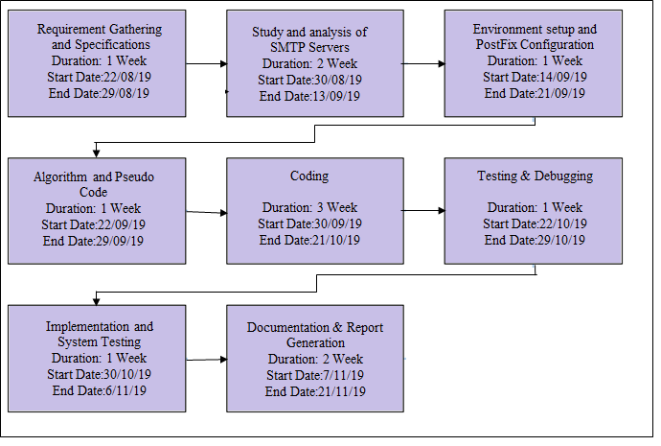
Pert Chart
Fig 3: PERT chart for the minor project

